Slide 1

HAYA: Encompassor of Offline LLM Utilizer
CS23621 – MOBILE APPLICATION DEVELOPMENT LABORATORY
Name: Kaif Rehman S.T
Roll Number:230701134
Department of Computer Science and Engineering
Date:16-06-2026

Slide 2

CONTENTS
01
Introduction
02
Problem Statement & Objectives
PART
PART
03
Project Overview
04
Platform & Technology Stack
PART
PART
05
System Architecture
06
Core Features
PART
PART
07
Streaming & User Experience
08
Markdown & Code Rendering
PART
PART

Slide 3
CONTENTS
09
Device Profiling & Recommendation Engine
10
Model hub & Download System
PART
PART
11
Performance, Stability & Safety
12
Output Showcase
PART
PART
13
Limitations & Future Enhancements
14
Conclusion & Thank You
PART
PART

Slide 4

PART 01
Introduction

Slide 5
The Need for Offline AI Systems
Introducing HAYA as a Solution
HAYA is a fully offline Android LLM framework designed as a privacy-focused mobile AI solution. It utilizes a local GGUF execution system to enable AI capabilities without requiring an internet connection.
Growth of LLMs and Cloud Limitations
Large Language Models have seen exponential growth, but cloud-based AI faces significant limitations. These include dependency on internet connectivity, which introduces latency and privacy concerns for sensitive mobile applications.

Slide 6
PART 02
Problem Statement & Objectives

Slide 7
Core Challenges with AI
Lack of Intelligent Model Recommendation
Cloud Dependency and Latency Issues
A key problem is the absence of a system that can intelligently recommend suitable AI models based on the user's specific device capabilities and needs.
Mobile applications relying on cloud AI suffer from internet requirements, leading to unpredictable latency. This is compounded by privacy concerns and poor optimization for mobile device constraints.

Slide 8


Project Objectives
Offline AI Chat and Local Execution
The primary objective is to enable fully offline AI chat with local GGUF execution. This includes real-time token streaming and a responsive user interface.
Device-Aware Model Recommendation
Another key goal is to implement a device-aware recommendation system that optimizes mobile performance by selecting the most appropriate model for the hardware.

Slide 9
PART 03
Project Overview

Slide 10

System Functionality Explained
GGUF Model Downloads and Inference
The system facilitates GGUF model downloads and uses llama.cpp JNI for local inference. It enables token-by-token streaming for a seamless user experience.
Dynamic Recommendation and Mobile Optimization
A dynamic recommendation engine is integrated to suggest models, and the entire system is designed for fully offline usage with specific mobile optimizations.

Slide 11
Key Characteristics
Offline-First and Privacy-Focused Design
HAYA is fundamentally an offline-first solution, ensuring low latency and a strong focus on user privacy. It is also device-adaptive to various Android hardware.

Slide 12
PART 04
Platform & Technology Stack

Slide 13

Android Configuration and Core Technologies
01
02
Android SDK and Kotlin Framework
Native and Inference Technologies
The application is built for Android with minSdk 26 and targetSdk 35. It is developed using Kotlin, Jetpack Compose, and leverages Coroutines and StateFlow for asynchronous operations.
The core inference relies on JNI, C++, and the llama.cpp library for executing GGUF models directly on the device.

Slide 14
PART 05
System Architecture

Slide 15
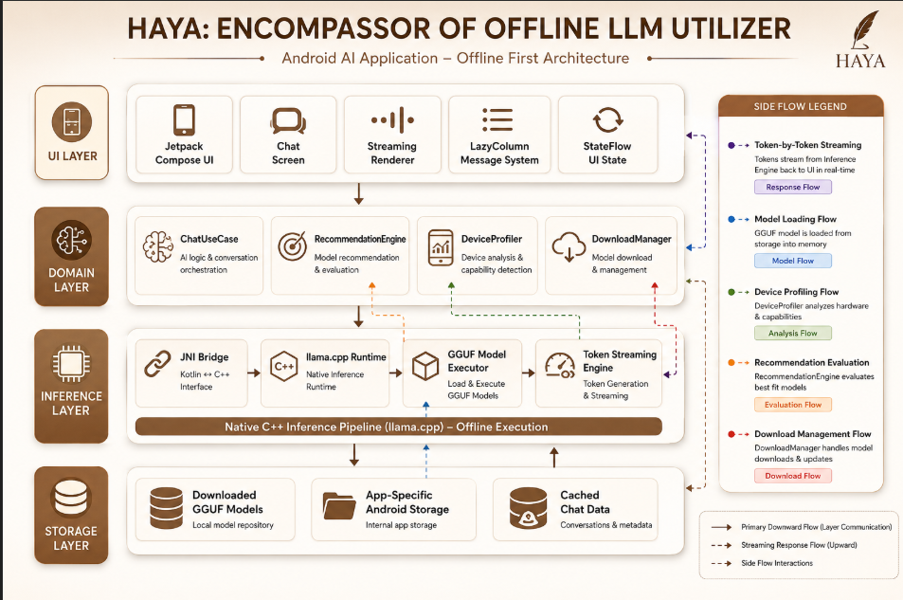

Slide 16
Layered Architecture Overview
UI, Domain, and Inference Layers
The architecture is divided into layers: a UI Layer with Jetpack Compose and StateFlow, a Domain Layer containing business logic, and an Inference Layer with JNI Bridge and llama.cpp Runtime.
Storage and Data Flow
The Storage Layer manages downloaded models and app storage. The system clearly separates UI from inference and manages streaming and model loading flows.

Slide 17
PART 06
Core Features

Slide 18
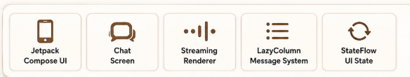
Foundational System Capabilities
01
Local Model Support and Native Inference
02
Mobile-Optimized UI and Safety
HAYA provides local GGUF model support and uses JNI-based native inference for efficient processing. It enables real-time streaming and fully offline chat capability.
The system includes a recommendation engine, safe lifecycle handling to prevent errors, and an optimized mobile UI for smooth interactions.

Slide 19
PART 07
Streaming & User Experience

Slide 20
Real-Time Interaction Features
Token-by-Token Streaming and Visual Indicators
The user experience is defined by token-by-token streaming, complemented by a thinking indicator and a blinking cursor for immediate feedback.
Smart Interaction and Scrolling
Features include incremental rendering, smooth transitions, and low-latency updates. Smart auto-scroll, a jump-to-bottom button, and streaming-safe scrolling enhance usability.

Slide 21
PART 08
Markdown & Code Rendering

Slide 22
Lightweight Markdown Support
Syntax Highlighting and Code Blocks
01
The system includes lightweight markdown support with syntax-highlighted code blocks. Keywords are blue, strings are green, and comments are gray for better readability.
Additional User Features
02
Users can copy the full message or individual code blocks. The terminal-style rendering provides a familiar coding environment.

Slide 23
PART 09
Device Profiling & Recommendation Engine

Slide 24
Hardware-Aware Model Selection
01
02
Device Profiling Metrics
Recommendation Logic and Categories
The engine profiles devices by detecting RAM, CPU cores, and ABI architecture. It calculates an estimated RAM requirement using the formula: estimatedRam = modelSize × 1.4.
The ratio of usable RAM to estimated RAM determines the model category: FAST, BALANCED, SLOW, or RISKY. This enables dynamic and flexible model selection.

Slide 25
PART 10
Model Hub & Download System

Slide 26


Downloadable Models and Management
Model Hub Features
The Model Hub offers downloadable GGUF models with recommended highlighting and performance indicators. It includes download progress tracking and retry mechanisms on failure.
Offline Availability
Models are stored in app-specific storage, ensuring they are available for offline use immediately after download.

Slide 27
PART 11
Performance, Stability & Safety

Slide 28

Ensuring a Reliable Experience
Performance Optimizations
The system is engineered for smooth streaming, low UI lag, and optimized rendering. It maintains stability even during long-response handling.
Safety Mechanisms
Safety features prevent overlapping generations, enable safe cancellation, and perform lifecycle cleanup. GGUF validation and comprehensive error handling are also implemented.

Slide 29
PART 12
Output Showcase

Slide 30
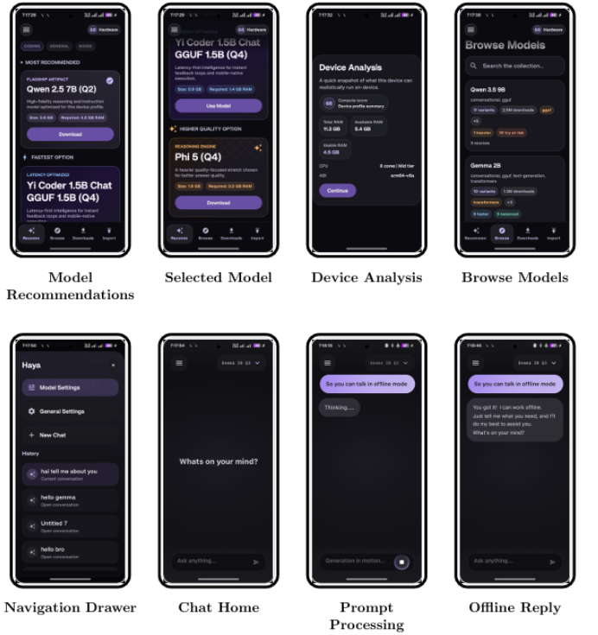

Slide 31

Realistic Android UI Mockups
Chat Interface and Streaming Responses
Model Hub and Recommendation System
This section showcases realistic Android UI mockups for the chat interface and streamed responses, demonstrating the practical application of HAYA.
Additional mockups illustrate the model hub, recommendation system, markdown rendering, download progress, and smart scrolling UI.

Slide 32
PART 13
Limitations & Future Enhancements

Slide 33

Current System Constraints
Known Limitations
Current limitations include limited markdown richness, no pause/resume functionality for downloads, and restricted metadata integration.

Slide 34

Planned Improvements
Future Development Roadmap
Future enhancements will focus on richer markdown support, improved model browsing, voice interaction capabilities, and deeper metadata integration.

Slide 35
PART 14
Conclusion & Thank You

Slide 36

HAYA's Practical Demonstration
Core Achievements
HAYA demonstrates practical offline LLM deployment on Android through native inference, optimized mobile UX, device-aware recommendation, and responsive offline AI interaction.

Slide 37

Acknowledgments
Thank You
We thank you for your attention and interest in HAYA, the Encompassor of Offline LLM Utilizer.

Slide 38
Thank you for watching.

